Slide 1
The ICT Engineer of the 21st Century:
Mastering Technical Competencies, Management Skills, and Societal Responsibilities (TeamSoc21)
An overview of the Erasmus+ Key Action 2 project
Vedran Podobnik and Jurica Babic
vedran.podobnik@fer.hr, jurica.babic@fer.hr
University of Zagreb
Faculty of Electrical Engineering and Computing
CROATIA
TeamSoc21 Valencia 2019 Multiplier Event
December 18-19, 2018, UPV, Valencia, SPAIN

Slide 2
Content
Brief history of consortium
TeamSoc21 project

Slide 3
Brief history
Start small, think big… in three phases ☺

Slide 4


Phase 1 aka Baby steps (2004-2011)
Originally initiated by partners from Leipzig and Valencia
Key principles
  To develop a multinational teaching in the fields of computer science and telecommunications communication technology.
  To stimulate the cooperation of students and teachers in multinational project groups.
  To contribute to the growing importance of intercultural skills.
  To give the teachers the opportunity to test new teaching and learning methods.
Realized as European Student Meetings (ESM)

Slide 5
European Student Meetings
  Gyor, Hungary [2004]
  Sant Petersburg, Russia [2005]
  Leipzig, Germany (topic: “Next Generations Network”) [2006]
  Lille, France (topic: “Optical Telecommunications and Mobile Telecommunications”) [2007]
  Zilina, Slovakia (topic: “Optical Telecommunications and Mobile Telecommunications”) [2008]
  Sofia, Bulgaria (topic: “Optical Telecommunications”) [2009]
  Gyor, Hungary (topic: “Telecommunication and ICT management”) [2010]
  Opatija, Croatia [2011]
EU funded / Not EU funded

Slide 6
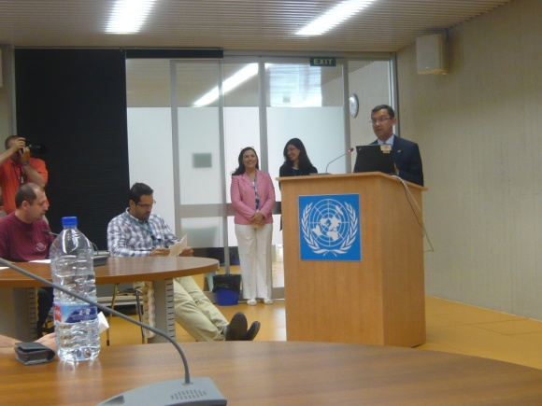
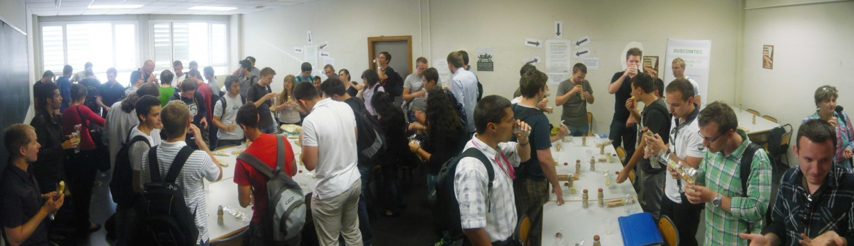
Phase 2 aka Consolidation (2012-2014)
Grant: LLP – Erasmus Mobility – Intensive Programmes (2007-2013)
  -Short programmes of study which bring together students and staff from higher education institutions of at least three participating countries-
Applicant: Universidad Politecnica Valencia (UPV)
Project: Intercultural knowledge transfer in engineering for a sustainable global ICT community (SUSCOMTEC)
Locations:
  Valencia, Spain [2012]
  Debrecen, Hungary [2013]
  Sofia, Bulgaria [2014]

Slide 7


Phase 3 aka Erasmus Key Action 2 (2014 - onwards)
Applicant: University of Zagreb Faculty of Electrical Engineering and Computing (UNIZG-FER)
Project #1: Innovative ICT Solutions for the Societal Challenges (INNOSOC) [2015-2017]
  Zagreb, Croatia [2016]
  Valencia, Spain [2017]
Project #2: The ICT Engineer of the 21st Century: Mastering Technical Competencies, Management Skills, and Societal Responsibilities (TeamSoc21) [2017-2019]
  Zagreb, Croatia [2018]
  Valencia, Spain [2019]

Slide 8

Recognition from EU:
SUCCESS STORY and
GOOD PRACTICE EXAMPLE
“Success Stories” are finalized projects that have distinguished themselves with their impact, contribution to policy-making, innovative results, creative approach and as a source of inspiration to others.
This is the first time that a project from Croatia received this recognition in the sector of higher education within the ERASMUS+ KA2 Strategic Partnerships framework.

Slide 9
TeamSoc21 project

Slide 10
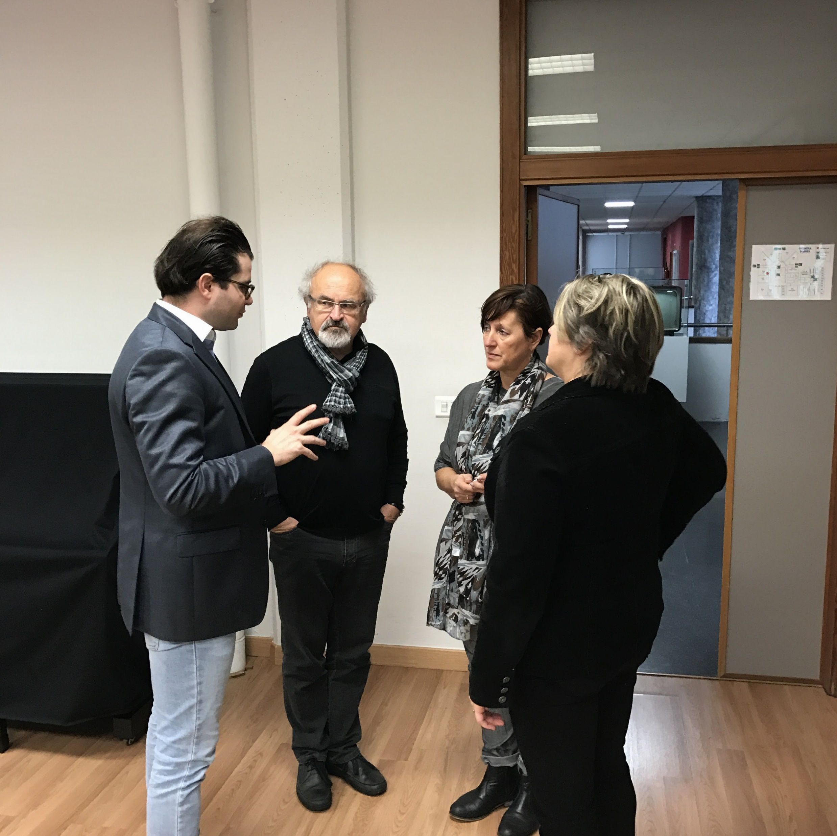
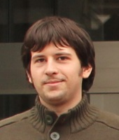
Background and Motivation
TeamSoc21 ICT Engineer
ICT Engineer
IDEA/OPPORTUNITY:
  Extreme demand in EU for highly skilled engineers
IMPACT:
  Multinational companies (100 000+ employees)
  100 000+ new start-up companies
CHALLENGE:
  (Re-)define the ICT engineer
  Define and execute education in the form of an intensive study program
TECHNICAL
SOCIETAL RESP.
MANAGEMENT
The project was brainstormed during the 2nd INNOSOC multiplier event in December 2016 (Valencia, Spain).
Notes:
IDEA:
Extreme demand in EU for highly skilled engineers
Crucial assets of the companies in the Industry 4.0 era which is ahead of us
IMPACT:
multinational companies (100 000+ employees)
100 000+ new start-up companies
CHALLENGE:
(Re-)define the ICT engineer
Define and execute education in the form of an extensive study program
PROPOSAL:
"The ICT Engineer of the 21st Century: Mastering Technical Competencies, Management Skills, and Societal Responsibilities (TEAMSOC21)"
OBJECTIVE:
“a transnational multidisciplinary intensive study program in the field of ICT-based entrepreneurship”

Slide 11
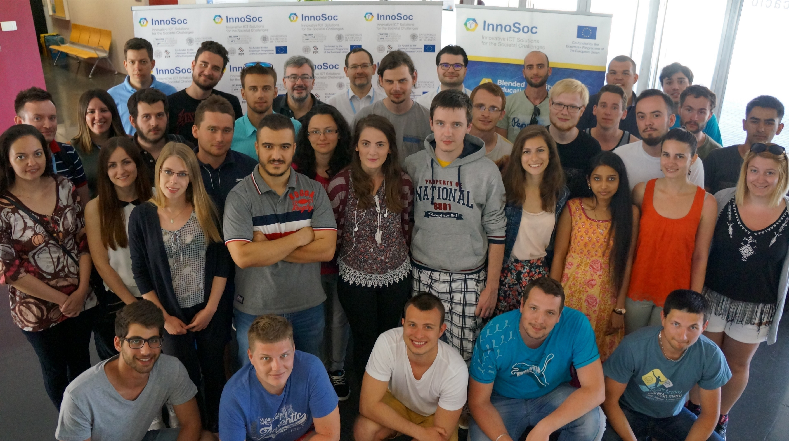
Our approach
"The ICT Engineer of the 21st Century: Mastering Technical Competencies, Management Skills, and Societal Responsibilities (TeamSoc21)"
  Timeframe: 1/9/2017-31/8/2019
  Budget: 224,137.00 EUR
GOAL:
“set up a transnational multidisciplinary intensive study program in the field of ICT-based entrepreneurship”
Key mechanisms:
  student teams with an expert guidance (entrepreneurial cases)
  blended mobility (virtual and physical mobility)
  build upon good practices from the previous project (INNOSOC)
Notes:
IDEA:
Extreme demand in EU for highly skilled engineers
Crucial assets of the companies in the Industry 4.0 era which is ahead of us
IMPACT:
multinational companies (100 000+ employees)
100 000+ new start-up companies
CHALLENGE:
(Re-)define the ICT engineer
Define and execute education in the form of an extensive study program
PROPOSAL:
"The ICT Engineer of the 21st Century: Mastering Technical Competencies, Management Skills, and Societal Responsibilities (TEAMSOC21)"
OBJECTIVE:
“a transnational multidisciplinary intensive study program in the field of ICT-based entrepreneurship”

Slide 12
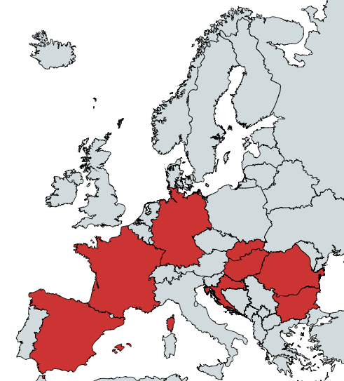
Current consortium (TeamSoc21)
11+1 universities from 8 EU countries
  Bulgaria (Sofia UTP, Sofia TU)
  Croatia (Zagreb, Osijek)
  France (Brest)
  Germany (Leipzig)
  Hungary (Gyor, Debrecen)
  Romania (Oradea)
  Slovakia (Kosice, Zilina)
  Spain (Valencia)

Slide 13
How? Retain good practices from INNOSOC and adjust accordingly
Consistent visual identity
Visibility & dissemination channels | Website: use similar styling, use the same domain (http://sociallab.education) Youtube: reuse the channel from INNOSOC Twitter: impact and reach was low, drop it Instagram: introduce #teamsoc21
Blended mobility | CHALLENGE: Entrepreneurial topics SOLUTION: acquire external industry partners

Slide 14
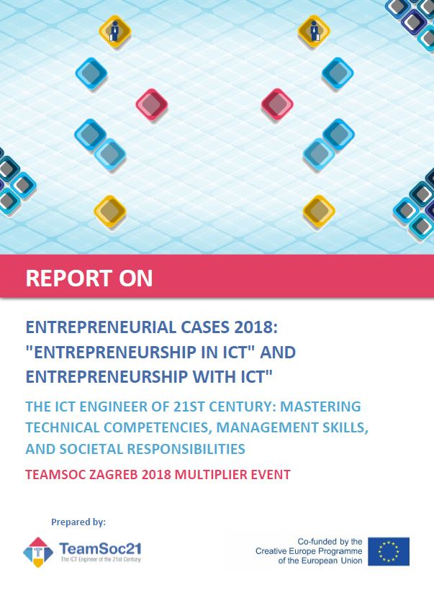
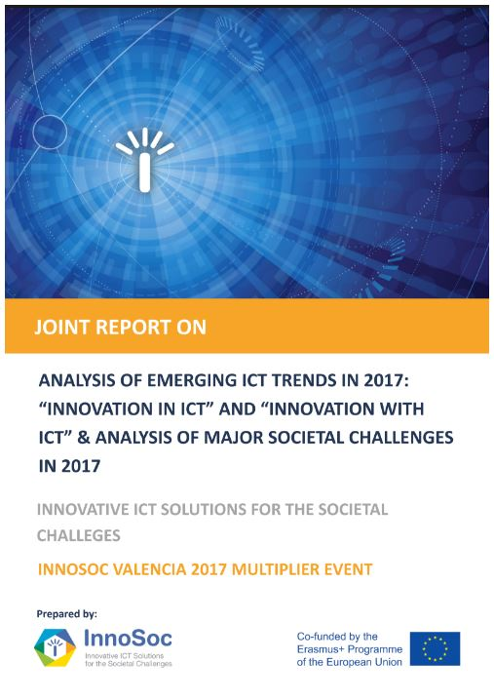
Think about sustainability!
Consortium-level - 15 years of experience!
Project-level
stay relevant!
Output-level
reinforce
project results from
previous projects
in new projects!
Sustainability
Innovative ICT Solutions
Entrepreneurship
???
e.g. TeamSoc21 USB stick
TeamSoc21 2018 Report
https://goo.gl/KzV9dV
INNOSOC 2017 Report
http://goo.gl/IM6Gcs
INNOSOC 2016 Report
https://goo.gl/oGz95B

Slide 15




Spread the word about the modern ICT engineer!
Make sure you like us on Facebook ☺
Post a photo on Instagram with #teamsoc21
Address: Unska 3, HR-10000 Zagreb, Croatia
E-mail: teamsoc21@fer.hr
Web: sociallab.education/teamsoc21
Facebook: facebook.com/teamsoc21
This document has been prepared for the European Commission however it reflects the views only of the authors, and the Commission cannot be held responsible for any use which may be made of the information contained therein.
Project reference: 2017-1-HR01-KA203-035408

