Slide 1
Case Study 6 - Sound
Re-Invention of the Role of Sound in Education

Slide 2
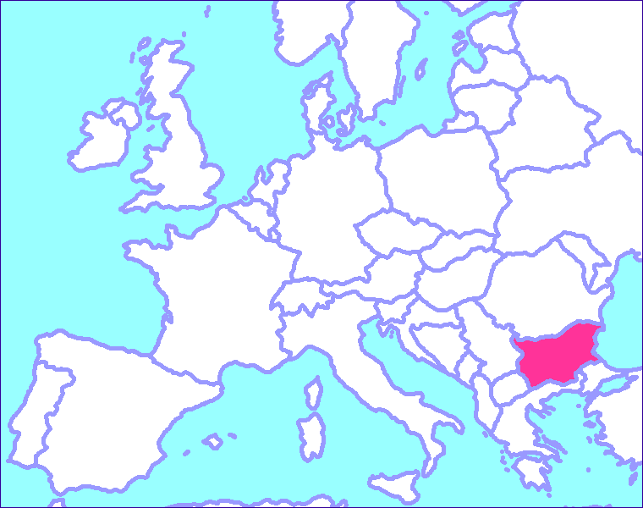
Valentina
20 Years Old
Sofia,Bulgaria
Communication and computer equipment, University of telecommunications and post
Computer administration of software applications
1st year student

Slide 3
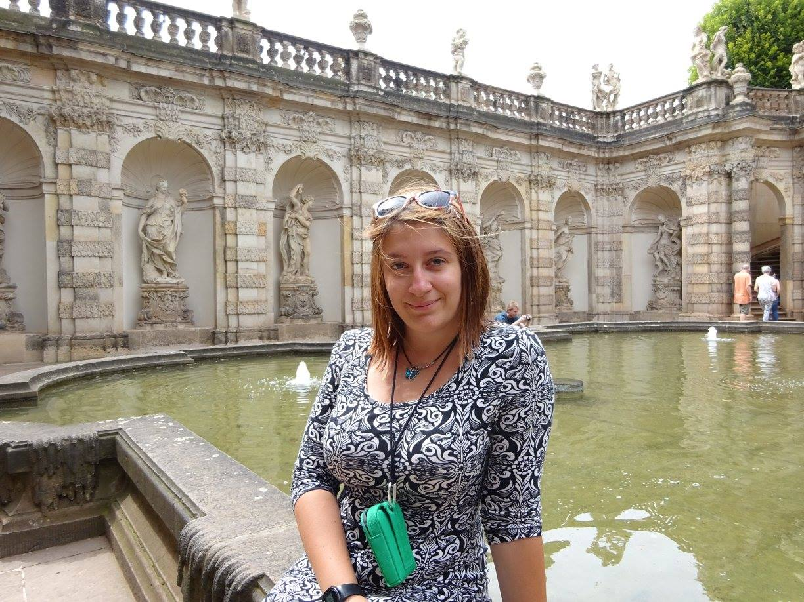
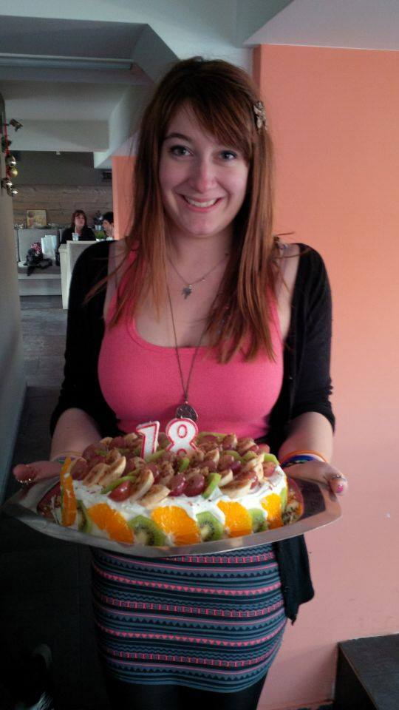
Tourism
Cooking
Hobbies…
Painting

Slide 4
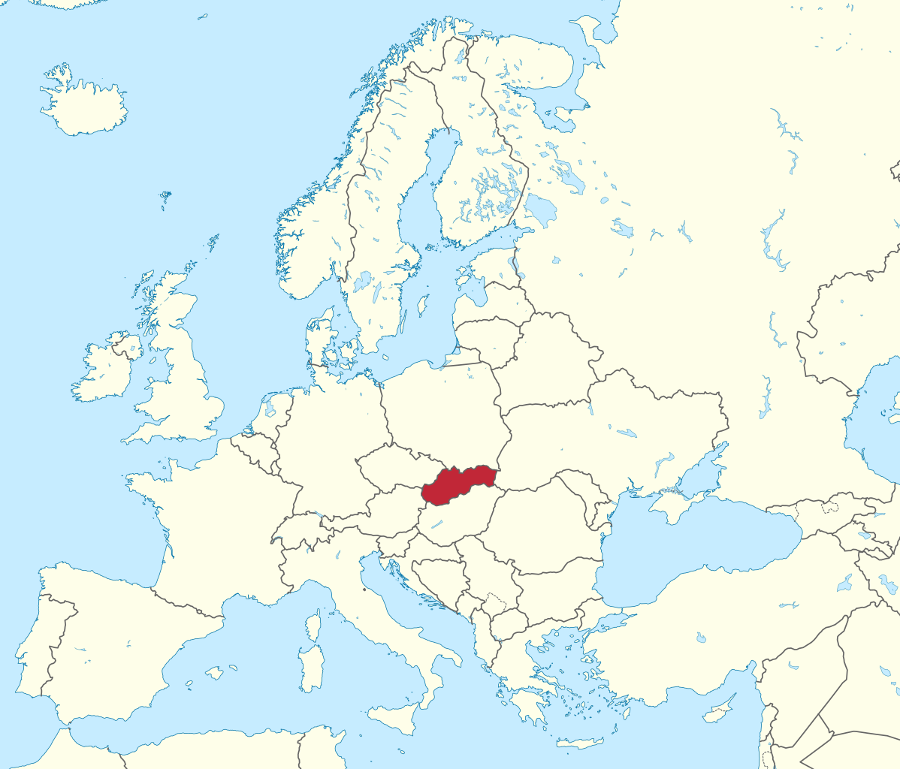
Patrik
24 Years Old
Nimnica, Slovakia
Faculty of Management Science and Informatics, University of Zilina
Informatic systems, aim Data processing
5th year student

Slide 5
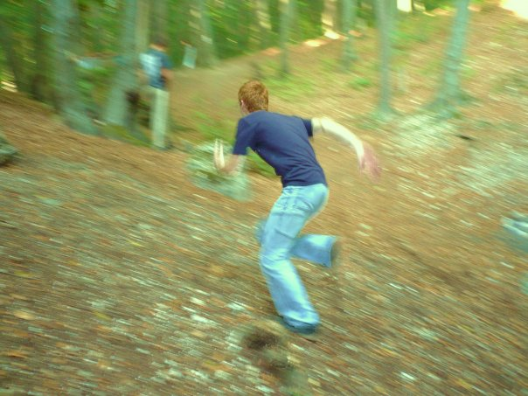
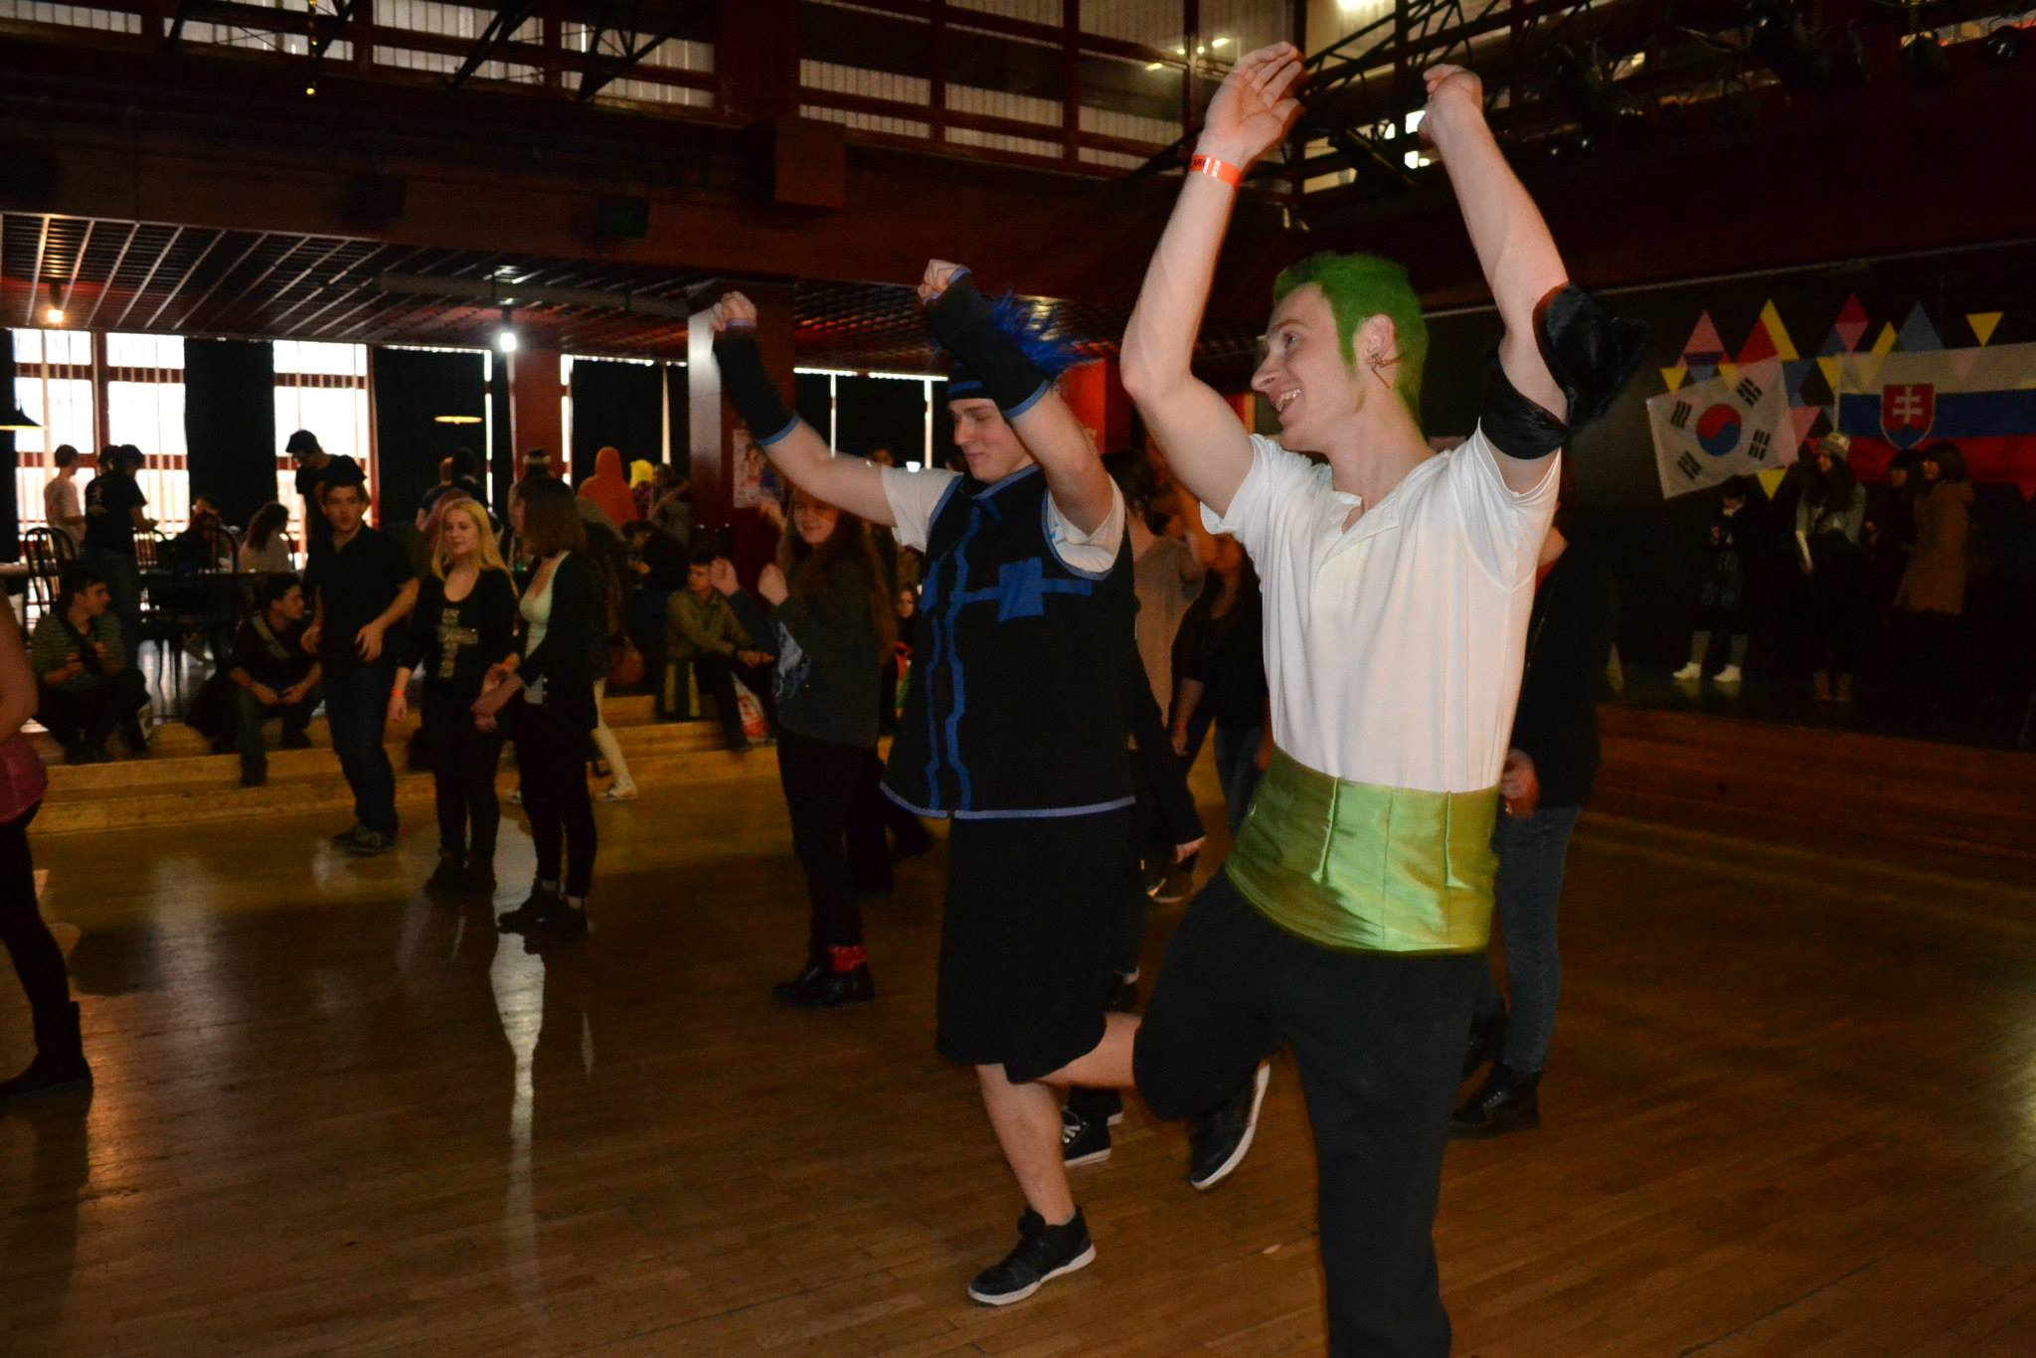
Hiking
Japanese culture
Hobbies…

Slide 6
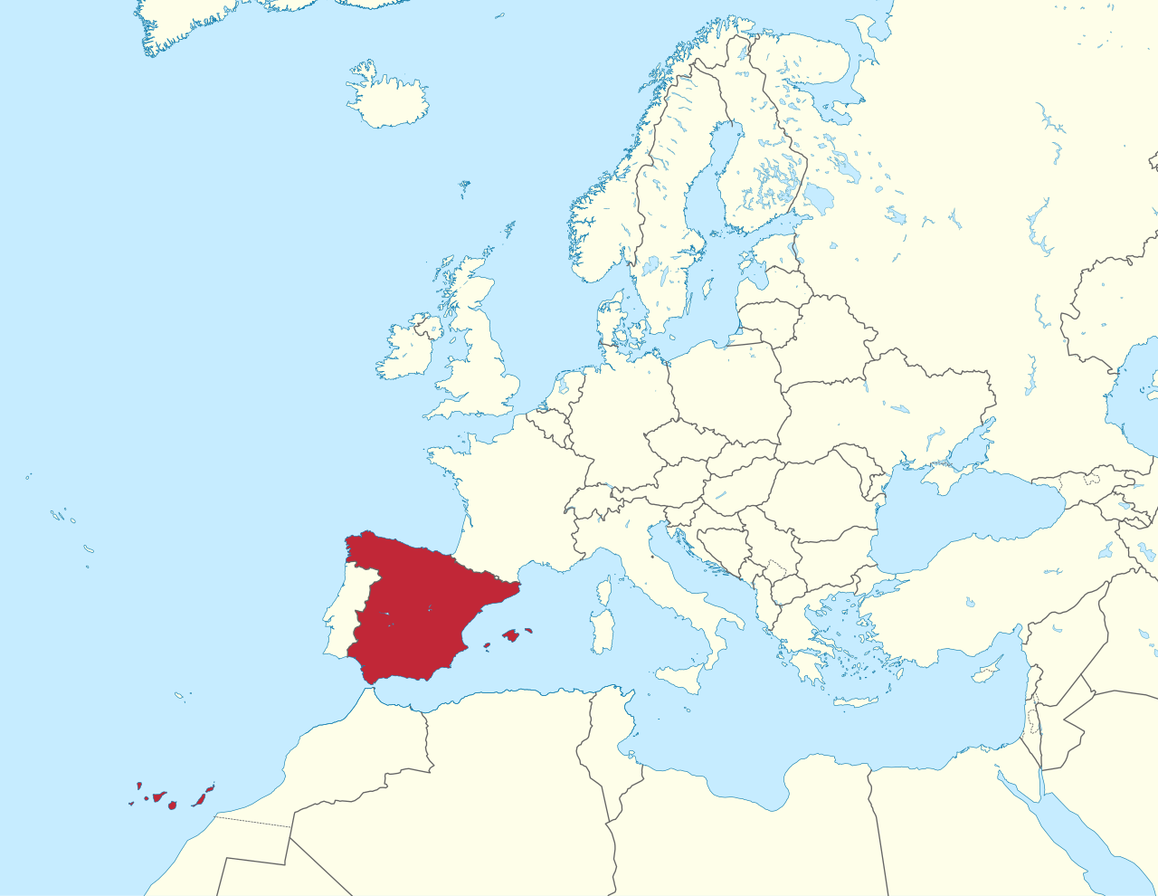
Raúl
20 Years Old
Valencia, Spain
Faculty of Telecommunications Technology Engineering, Polytechnic University of Valencia
Bachelor's Degree in Telecommunications Technology Engineering
3rd year student

Slide 7
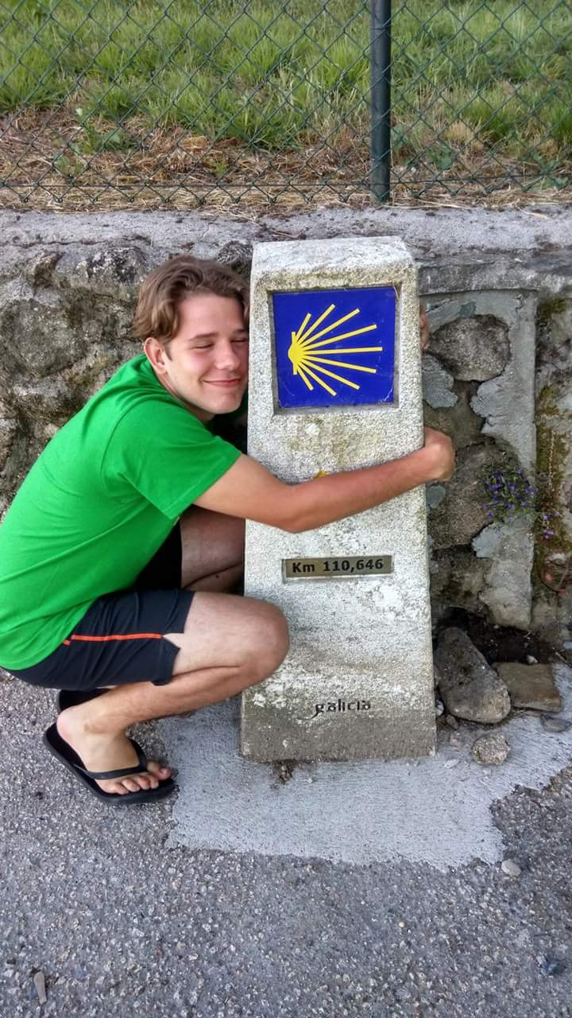
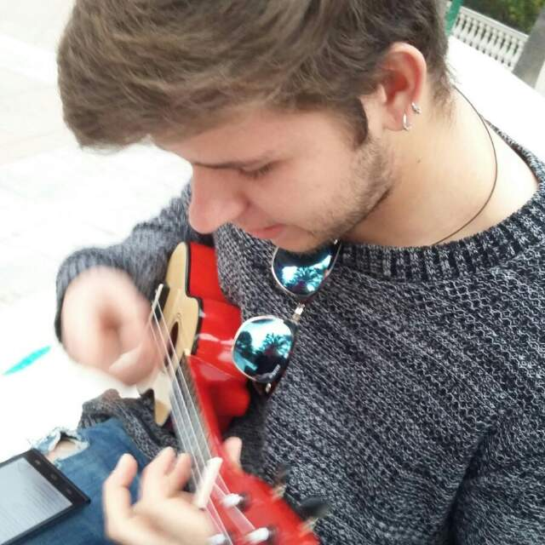
Camping
Music
Hiking
Hobbies…

Slide 8
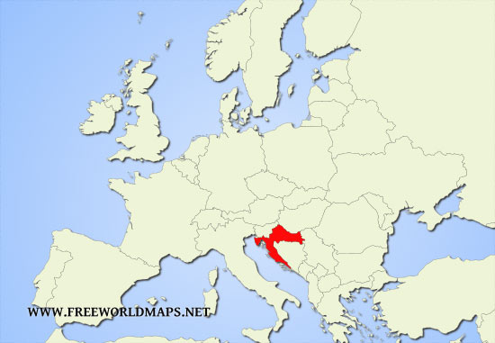
Leon
23 Years Old
Petrinja, Croatia
Faculty of Electrical Engineering and Computing, University of Zagreb
Information and Communication Technology
5th year student

Slide 9
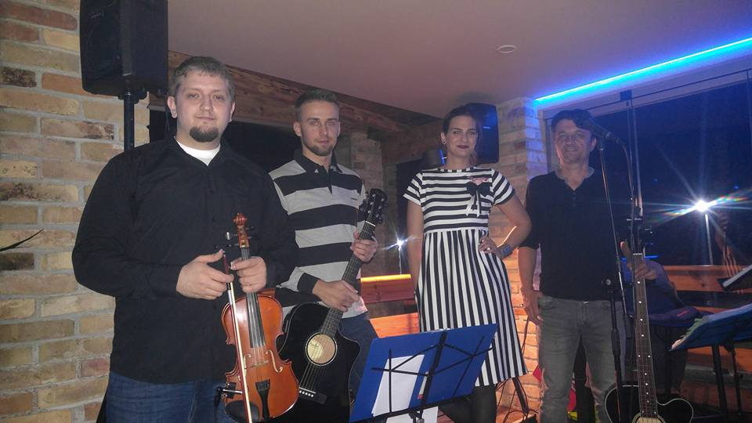
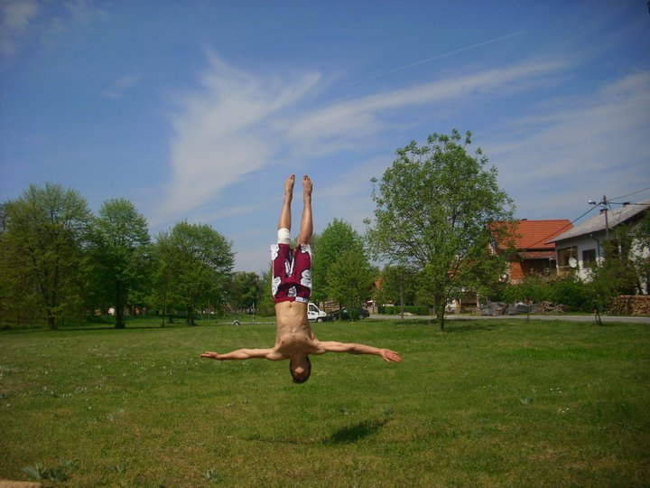
Music
Hobbies…
Gymnastics

Slide 10
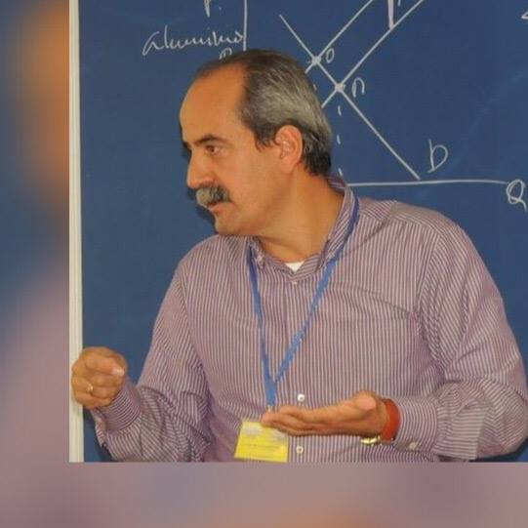
Our supervisor
Carlos Hernández Franco
Professor of the Communications Department
Faculty of Telecommunications Technology Engineering, Polytechnic University of Valencia
Teaching Innovation Projects
Workshops for teachers aimed at improving educational methods and the quality of teaching

Slide 11
We work on…

Slide 12
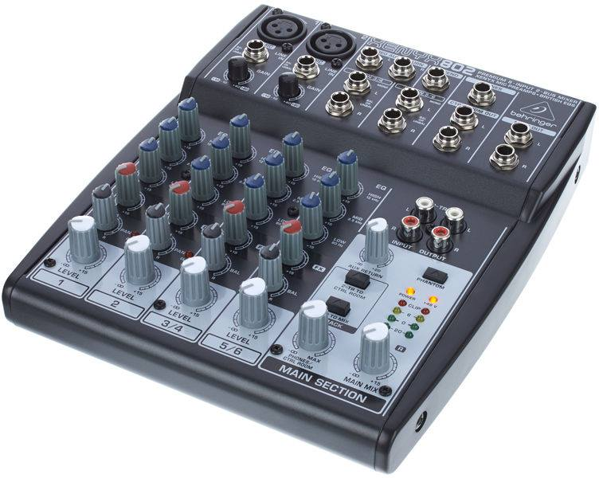
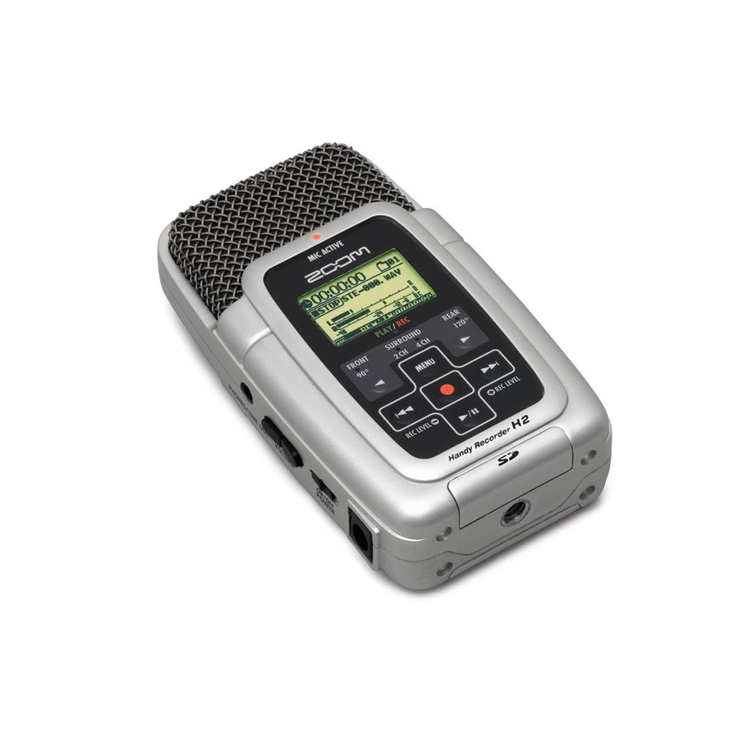
Devices
Behringer C1 Microphone
H2 Zoom digital Recorder
Behringer XENYX 802 Mixer

Slide 13
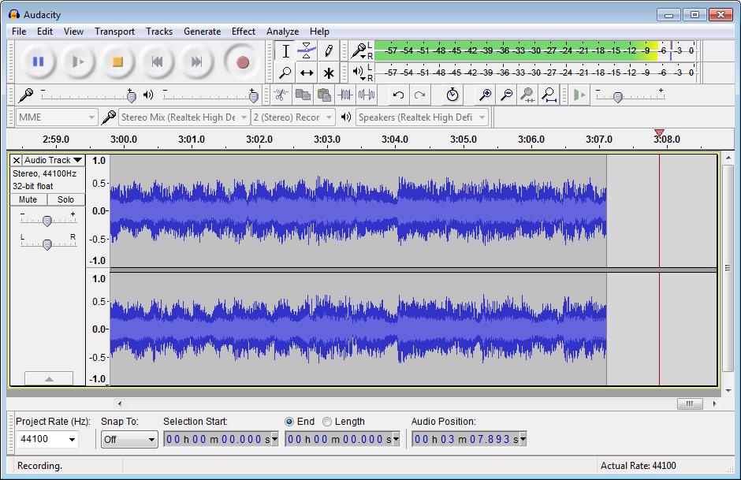
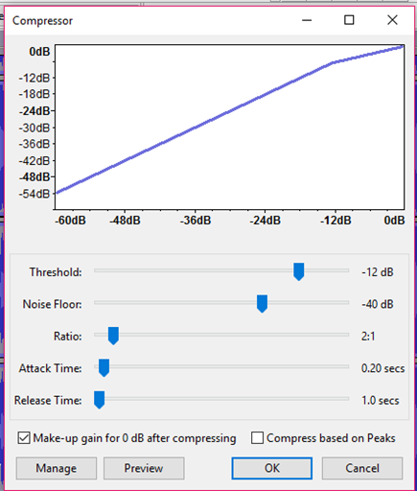
Audacity is digital audio editor and recording application. It is open source, free and available for Windows, OS X, and Linux.
It has several menus from which we obtained information about its use, from filters to effects.

Slide 14
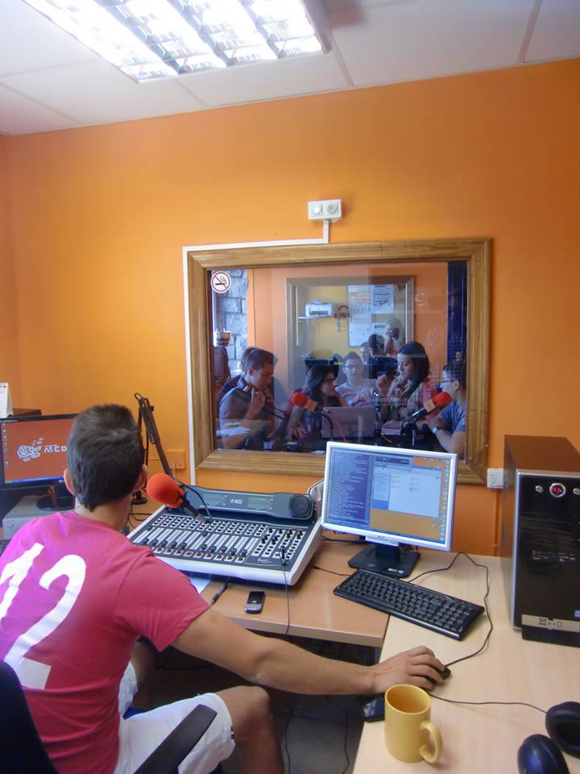
Broadcasting

Slide 15
Despite the distance and the lack of previous knowledge

Slide 16
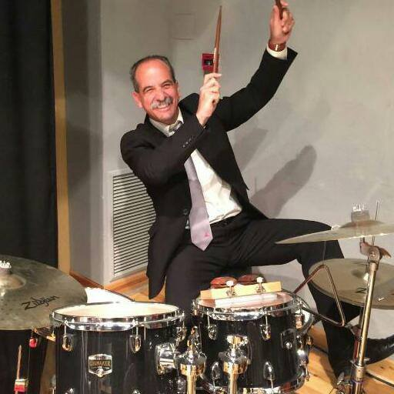
We have…
Good and accessible lecturer
Desire to work, learn and cooperate
Equal engagement

Slide 17
We successfully use…
Google Drive/Docs:
File storage
Synchronization service
Collaboration
Facebook:
Communication
Receive tasks
Report our results

Slide 18
That make us…

Slide 19
The end
Thank you for your time!
Leon, Patrik, Raul, Valentina

